Slide 1
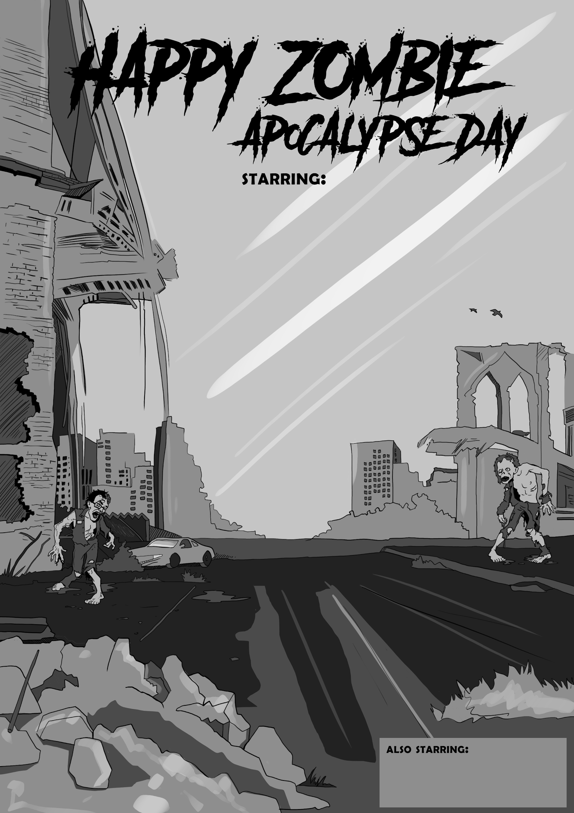
Happy
Zombie
Apocalypse Day
V 1.1
A unit about Disease where you need to fight to survive!

Slide 2
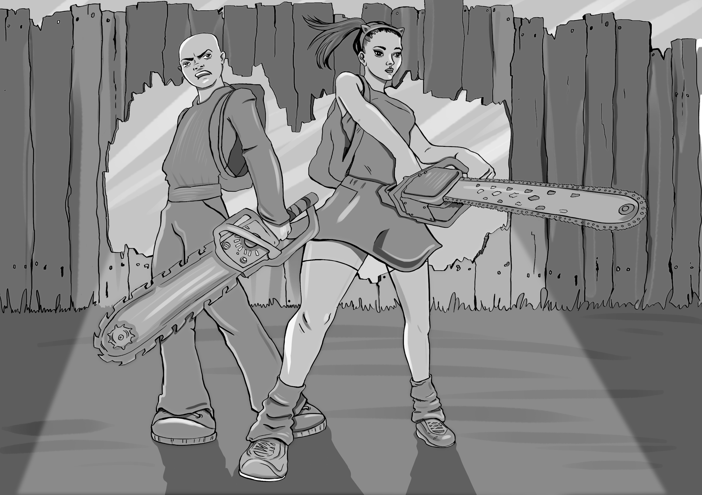
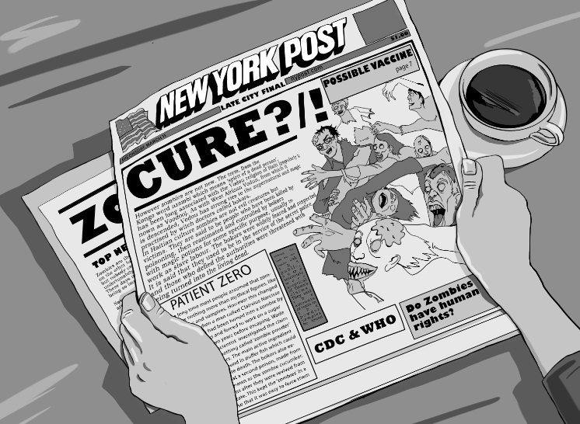
Happy Zombie
Apocalypse Day
A GAmification Schoolhouse creation
Version 1.1 | Copyright 2016-2020
Designed and written by Eric Nelson
Artwork by Gergana Zmiycharova

Slide 3
Temporary Slide- Read and delete
This presentation comes in two major parts; first the narrative game path that organizes the experience, and second the “game” mechanics.
You should note that the slides pertaining to the “Survivors Path” [slides 8-14] all have a white text box at the bottom of each slide. This is for you to use, edit, or delete as needed. There is one suggested activity link that I included in this presentation on slide 12 as I feel it is important one to share, and it honors the CDC page that inspired this work.
You may or may not have purchased the optional “Guidebook to the Zombie Apocalypse” when you downloaded this. If you did, some of the included activities could be cut and pasted into these editable text boxes. The guidebook also provides some great zombie information to up your zombie credibility.

Slide 4
“Brains… ”
Zombies. They are everywhere it seems. Zombies are in our music, movies, games, and even on the Website for the U.S. Centers for Disease Control (CDC)!
Who is the CDC? Well, their mission statement is as follows:
The CDC works 24/7 to protect America from health, safety and and related medical security threats, both foreign and in the U.S. Whether diseases start at home or abroad, are chronic or acute, curable or preventable, human error or deliberate attack, the CDC fights disease and supports communities and citizens to do the same.
CDC increases the health security of our nation. As the nation’s health protection agency, CDC saves lives and protects people from health threats. To accomplish our mission, CDC conducts critical science and provides health information that protects our nation against expensive and dangerous health threats, and responds when these arise.
So why are they talking about zombies on their Website, and is there something you should know? There is. You will need to know a lot of things if you were to survive a Zombie Apocalypse, but let’s not get ahead of ourselves.

Slide 5
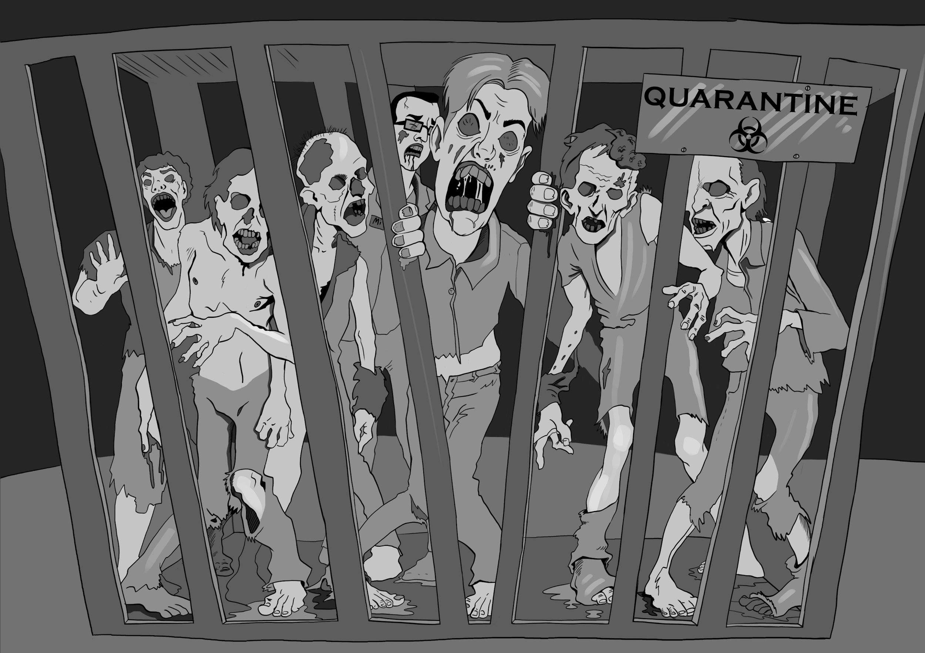
About that
More zombie facts and disease activities in the “Teachers Guidebook to the Zombie Apocalypse” available at www.gamificationschoolhouse.com or at Teacher Pay Teachers
In fiction there are three ways to create zombies: magic, radiation, and an infectious pathogen.
Who are these walking dead? Are they sick humans? What exactly do we mean by dead? If it’s a pathogen, can we cure it? What would a cure look like?
For the record, this unit uses a zombie with the following traits: it’s infected with an unknown pathogen, it moves slowly, it’s compelled to bite healthy humans, and it’s not very smart.
Do zombies, or the infected, have human rights?

Slide 6
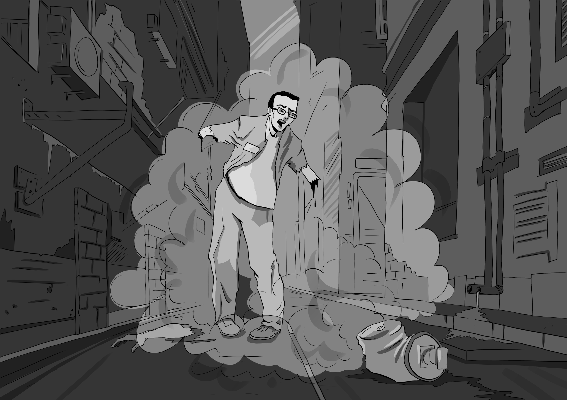
The Survivor’s Path
You are about to start a themed unit where you will learn about disease. What causes it, how we have gotten better at fighting it, and yes, how you can prepare for it or something like a zombie apocalypse.
The learnings about disease and the expectations around them are real. The CDC and I use zombies because: 1) they represent a “worst case scenario” against which we can test and examine our understandings about disease, and 2) Zombies are cool, beyond their obvious thermodynamics.
“The ZAP grenade is working!”
-Andy
“Don’t get too close, Andy. They said there might be exposure side effects.”
-Nikki

Slide 7
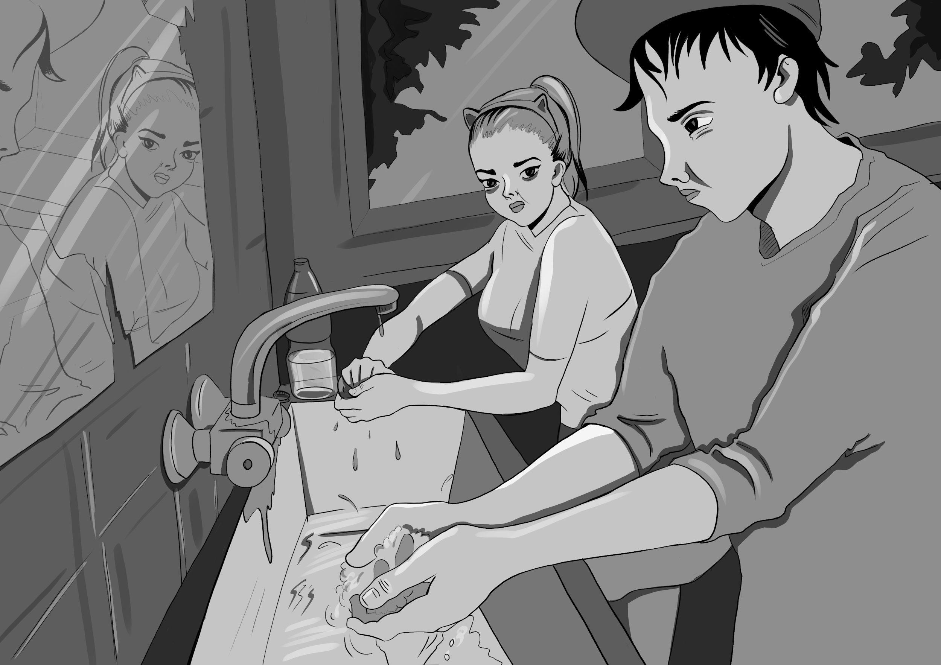
The Survivor’s Path
Essential behaviors in a zombie apocalypse:
You and your classmates are about to take a journey along the survivor’s path. At the end of that path is Happy Zombie Apocalypse Day.
Each step of the survivor’s path will have its own activities and learnings that will help you be better prepared for a zombie apocalypse.
You should now review each step of the Survivor’s Path Guide and then the requirements for the Happy Zombie Apocalypse Day before you begin your journey. Read on.
“Make sure you wash everything it touched. We can’t afford to get sick now.”
-Nikki
“I know, I know. I really don’t want to become a zombie.”
-Andy

Slide 8
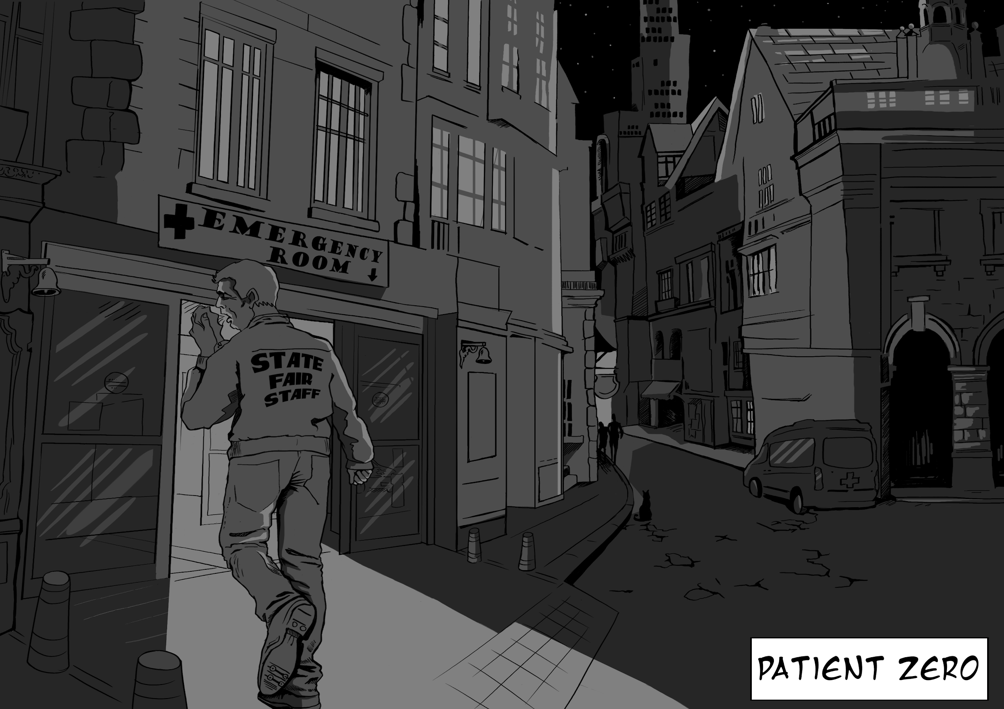
Survivor’s Path - Patient Zero
Essential Question: Why is identifying patient zero vital to our understanding of a disease, its’ spread, and the disease triangle?
“How did this all start?” In the event of a zombie apocalypse, it would be vital to end it quickly. There have been a number of models created to simulate how diseases, with different rates of contagion, virality, mortality, and modes of spread might spread across the world. The math tells us that we would need to act fast with any disease! In a recent outbreak of Ebola, a lack of proper contact tracing was identified as a primary reason the disease crossed so many borders.
Vocabulary:
Activity:

Slide 9
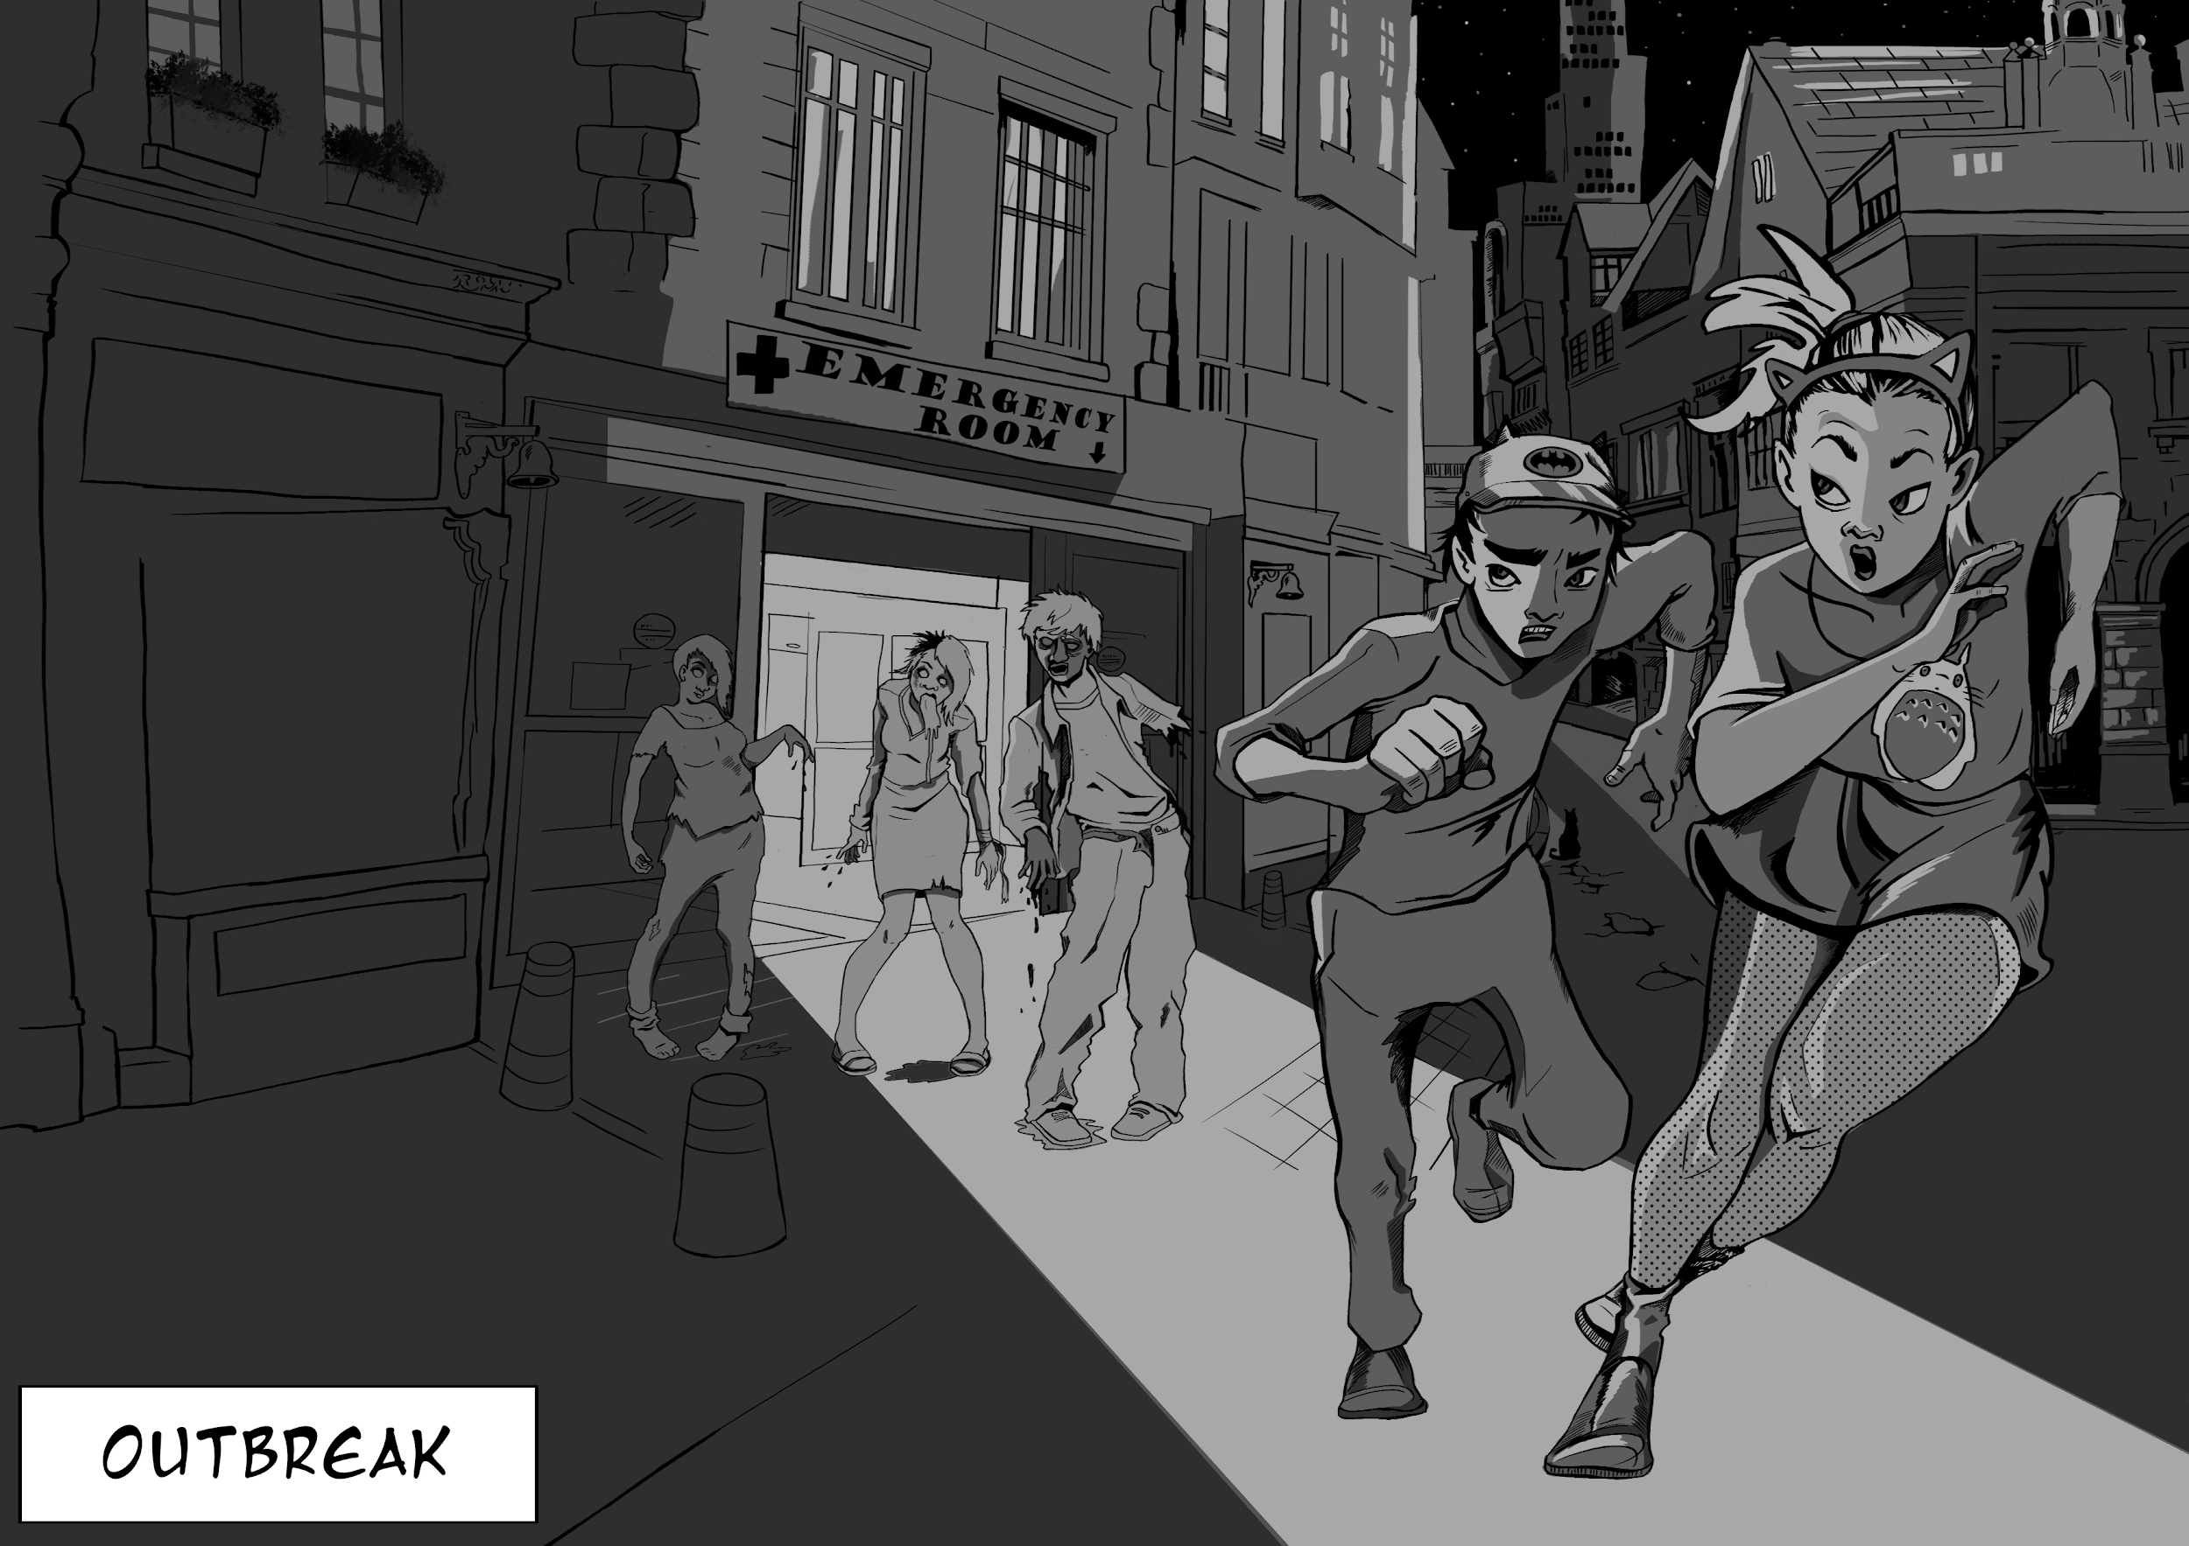
Survivor’s Path - Outbreak!
Essential Question: What makes an outbreak dangerous to society?
An outbreak of a disease marks the point that the growth in the number of new cases in an area exceeds what might normally be there. Even if you are not sick, you might now notice that those around you are getting sick. Knowing correctly how the disease spreads (also known as the disease vector) is a very important piece of knowledge to have if you want to also avoid getting infected. Medical systems would have to be careful to treat the sick without exposing others to the disease.
Vocabulary:
Activity:

Slide 10
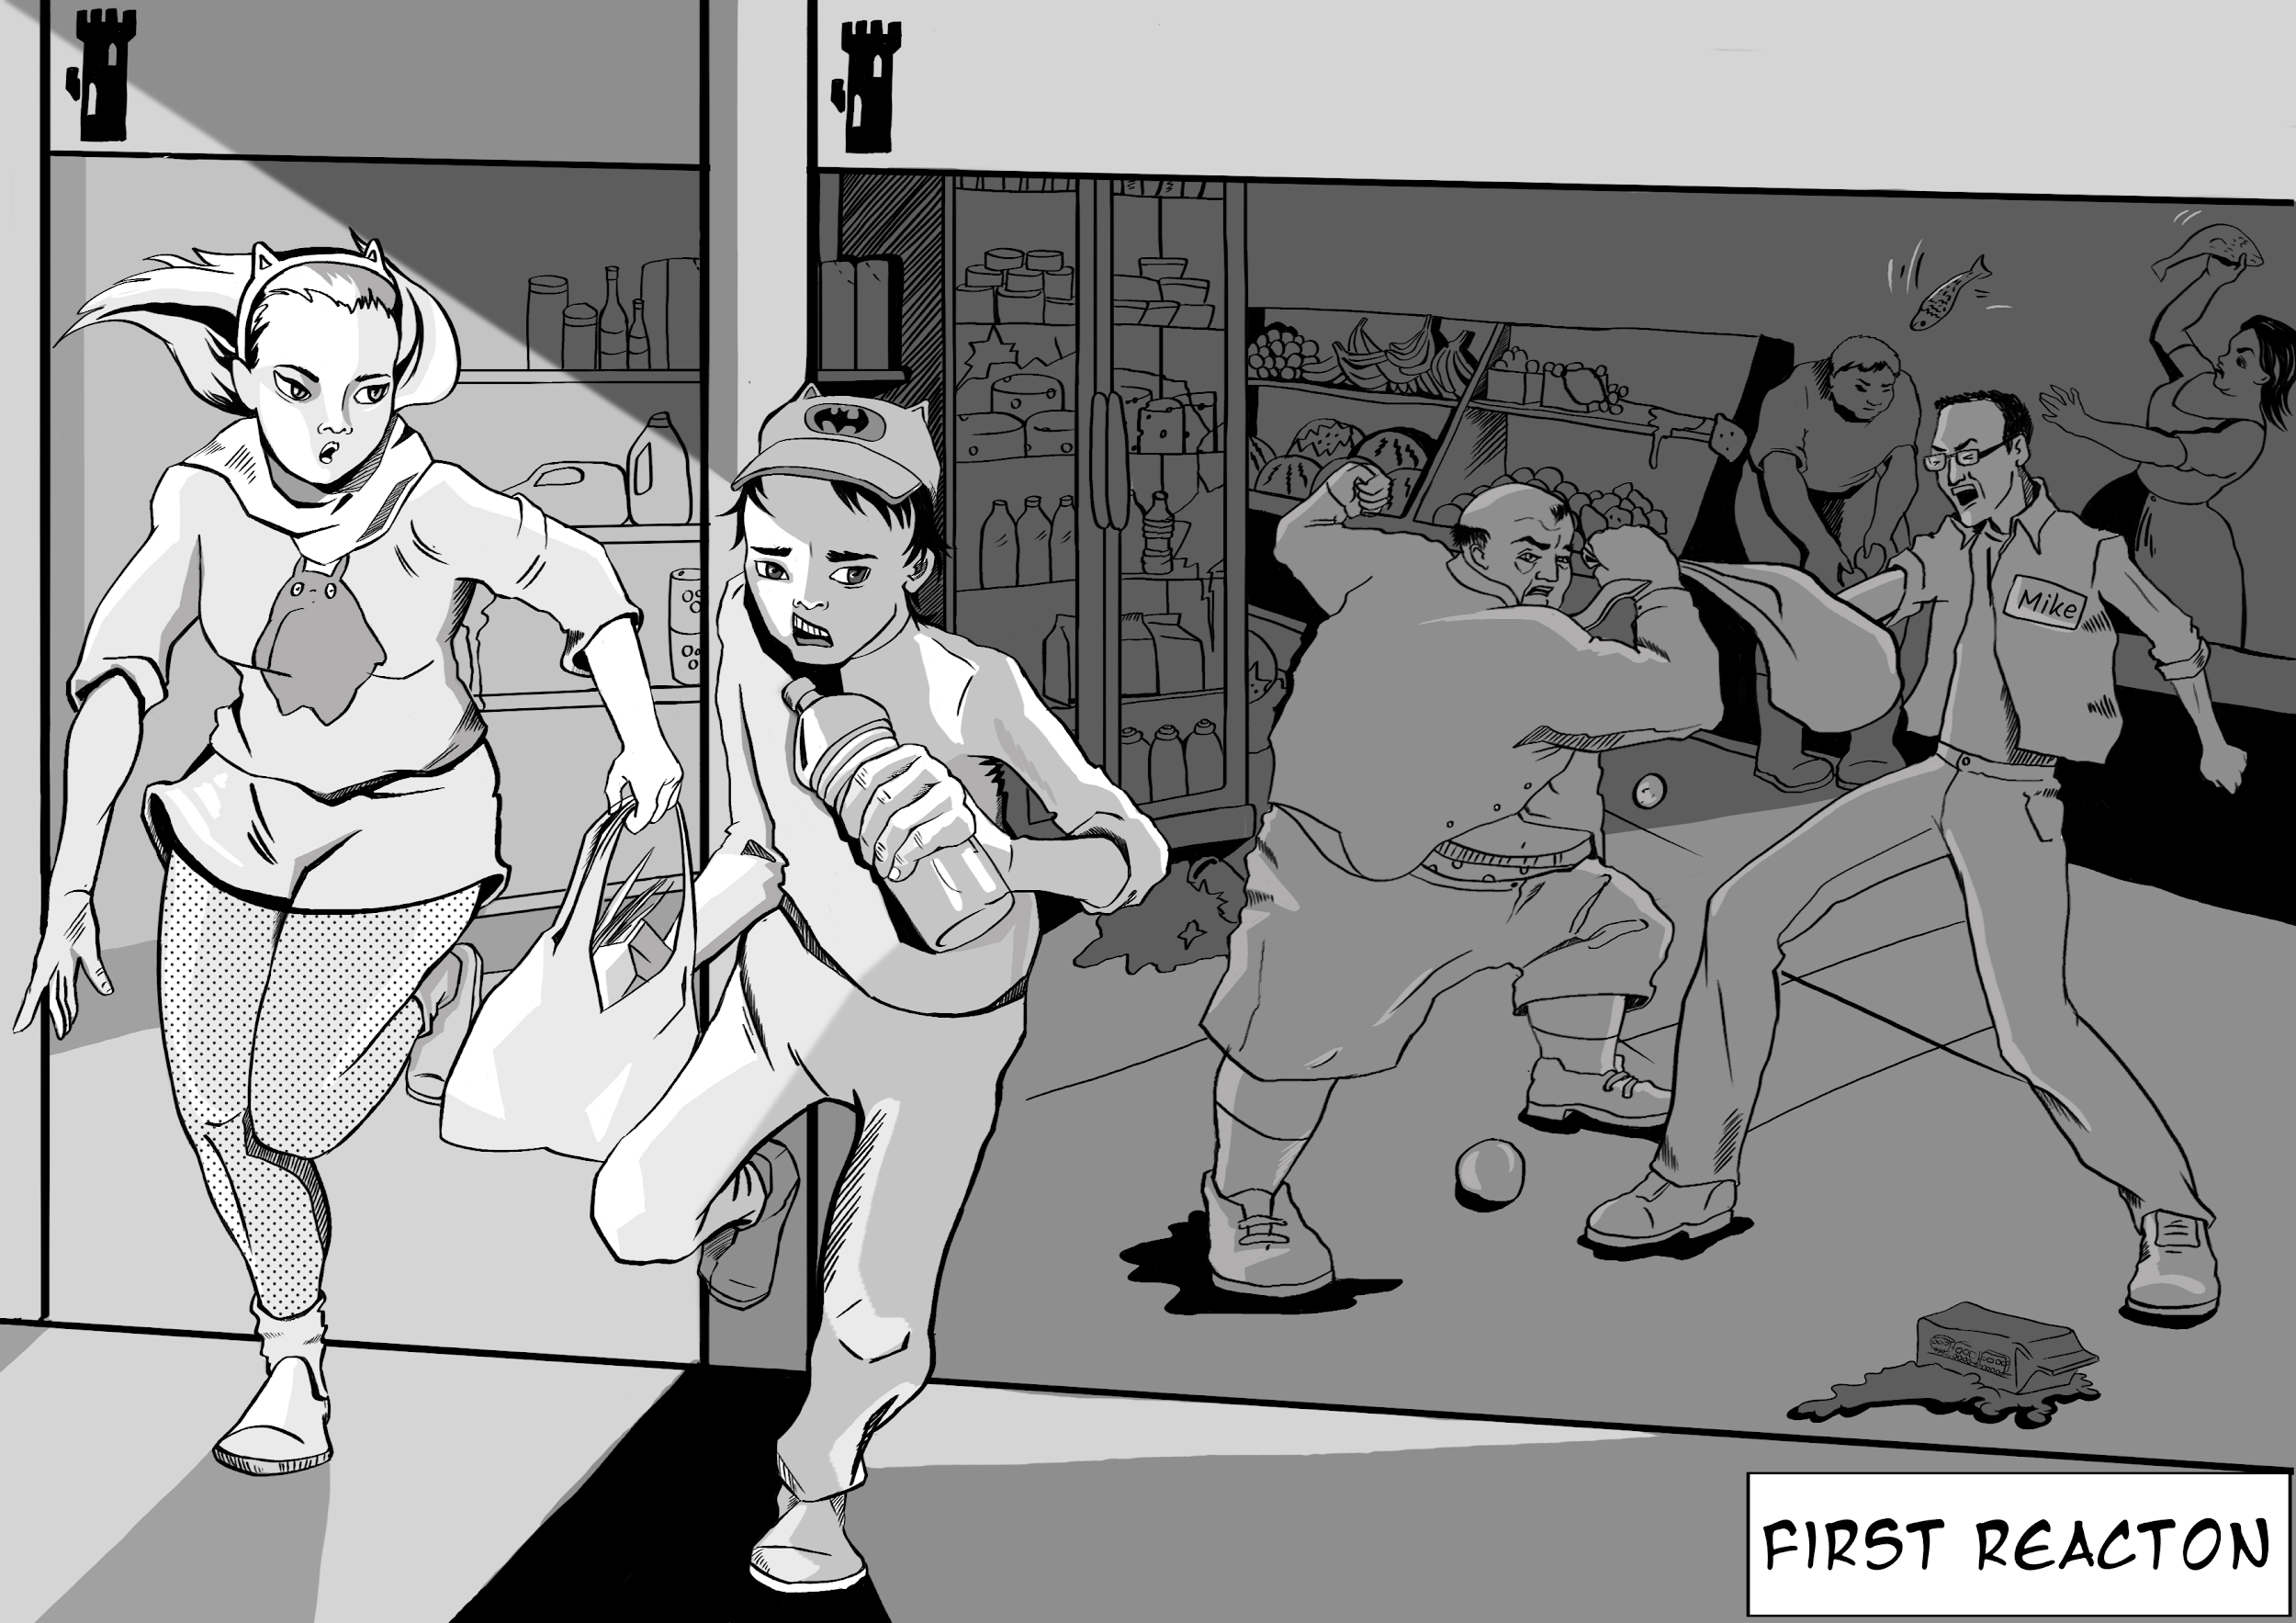
Survivor’s Path - First Reaction
Essential Question: How does fear affect critical thinking, and why is critical thinking important in protecting yourself in an outbreak?
There is a natural aversion to disease. A zombie apocalypse is a worst case scenario for the spread of a disease. What is so frightening is that the victims of the disease (are they really dead?) are now a vector for the disease. Knowing; how a disease is spread, if there is a cure or treatment, and knowing what you can do that will or will not protect you, is an important skill set if you are to be prepared for the apocalypse and avoid making mistakes due to fear.
Vocabulary:
Activity:

Slide 11
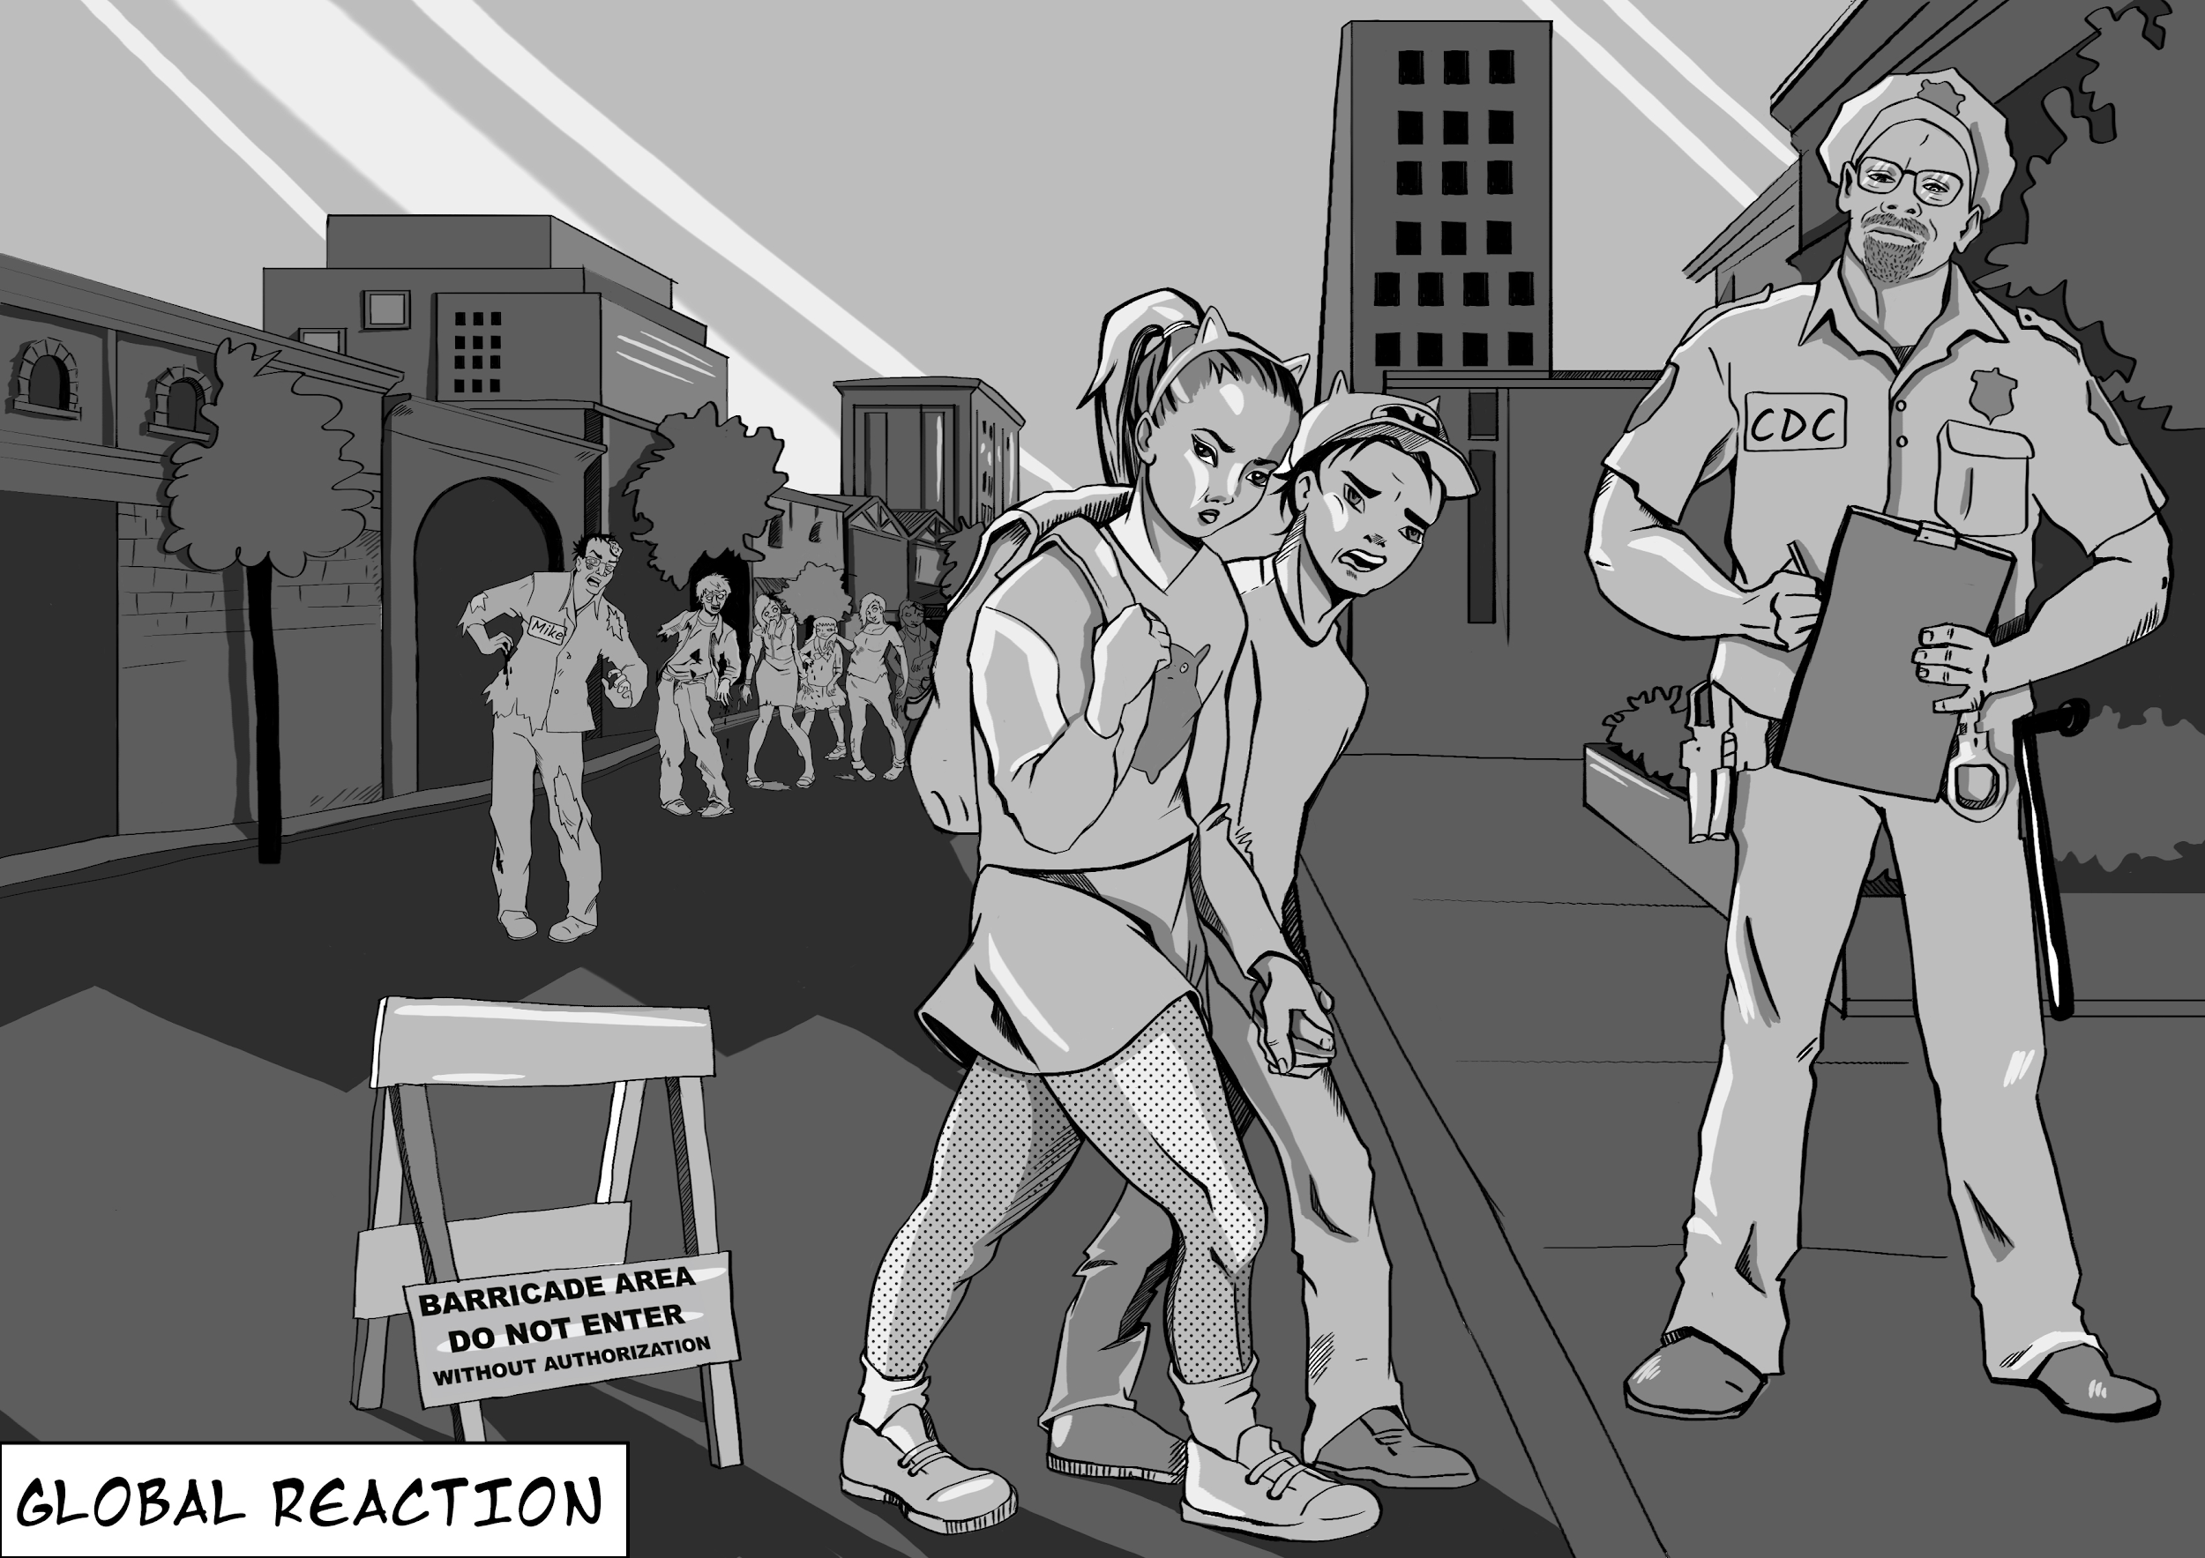
Survivor’s Path - Global Reaction
Essential Question: Do zombies, or the infected, have human rights?
What is death? If they are walking, can zombies be dead? We need to remember what life is. Death for humans is not so much an event but a process. This process can at times be reversed with techniques such as CPR, electric shock, and other life saving techniques.
So who are the walking dead? Do they have rights? Do sick, or mentally ill humans have rights? Does society have rights that supersede these rights?
Vocabulary:
Activity:

Slide 12
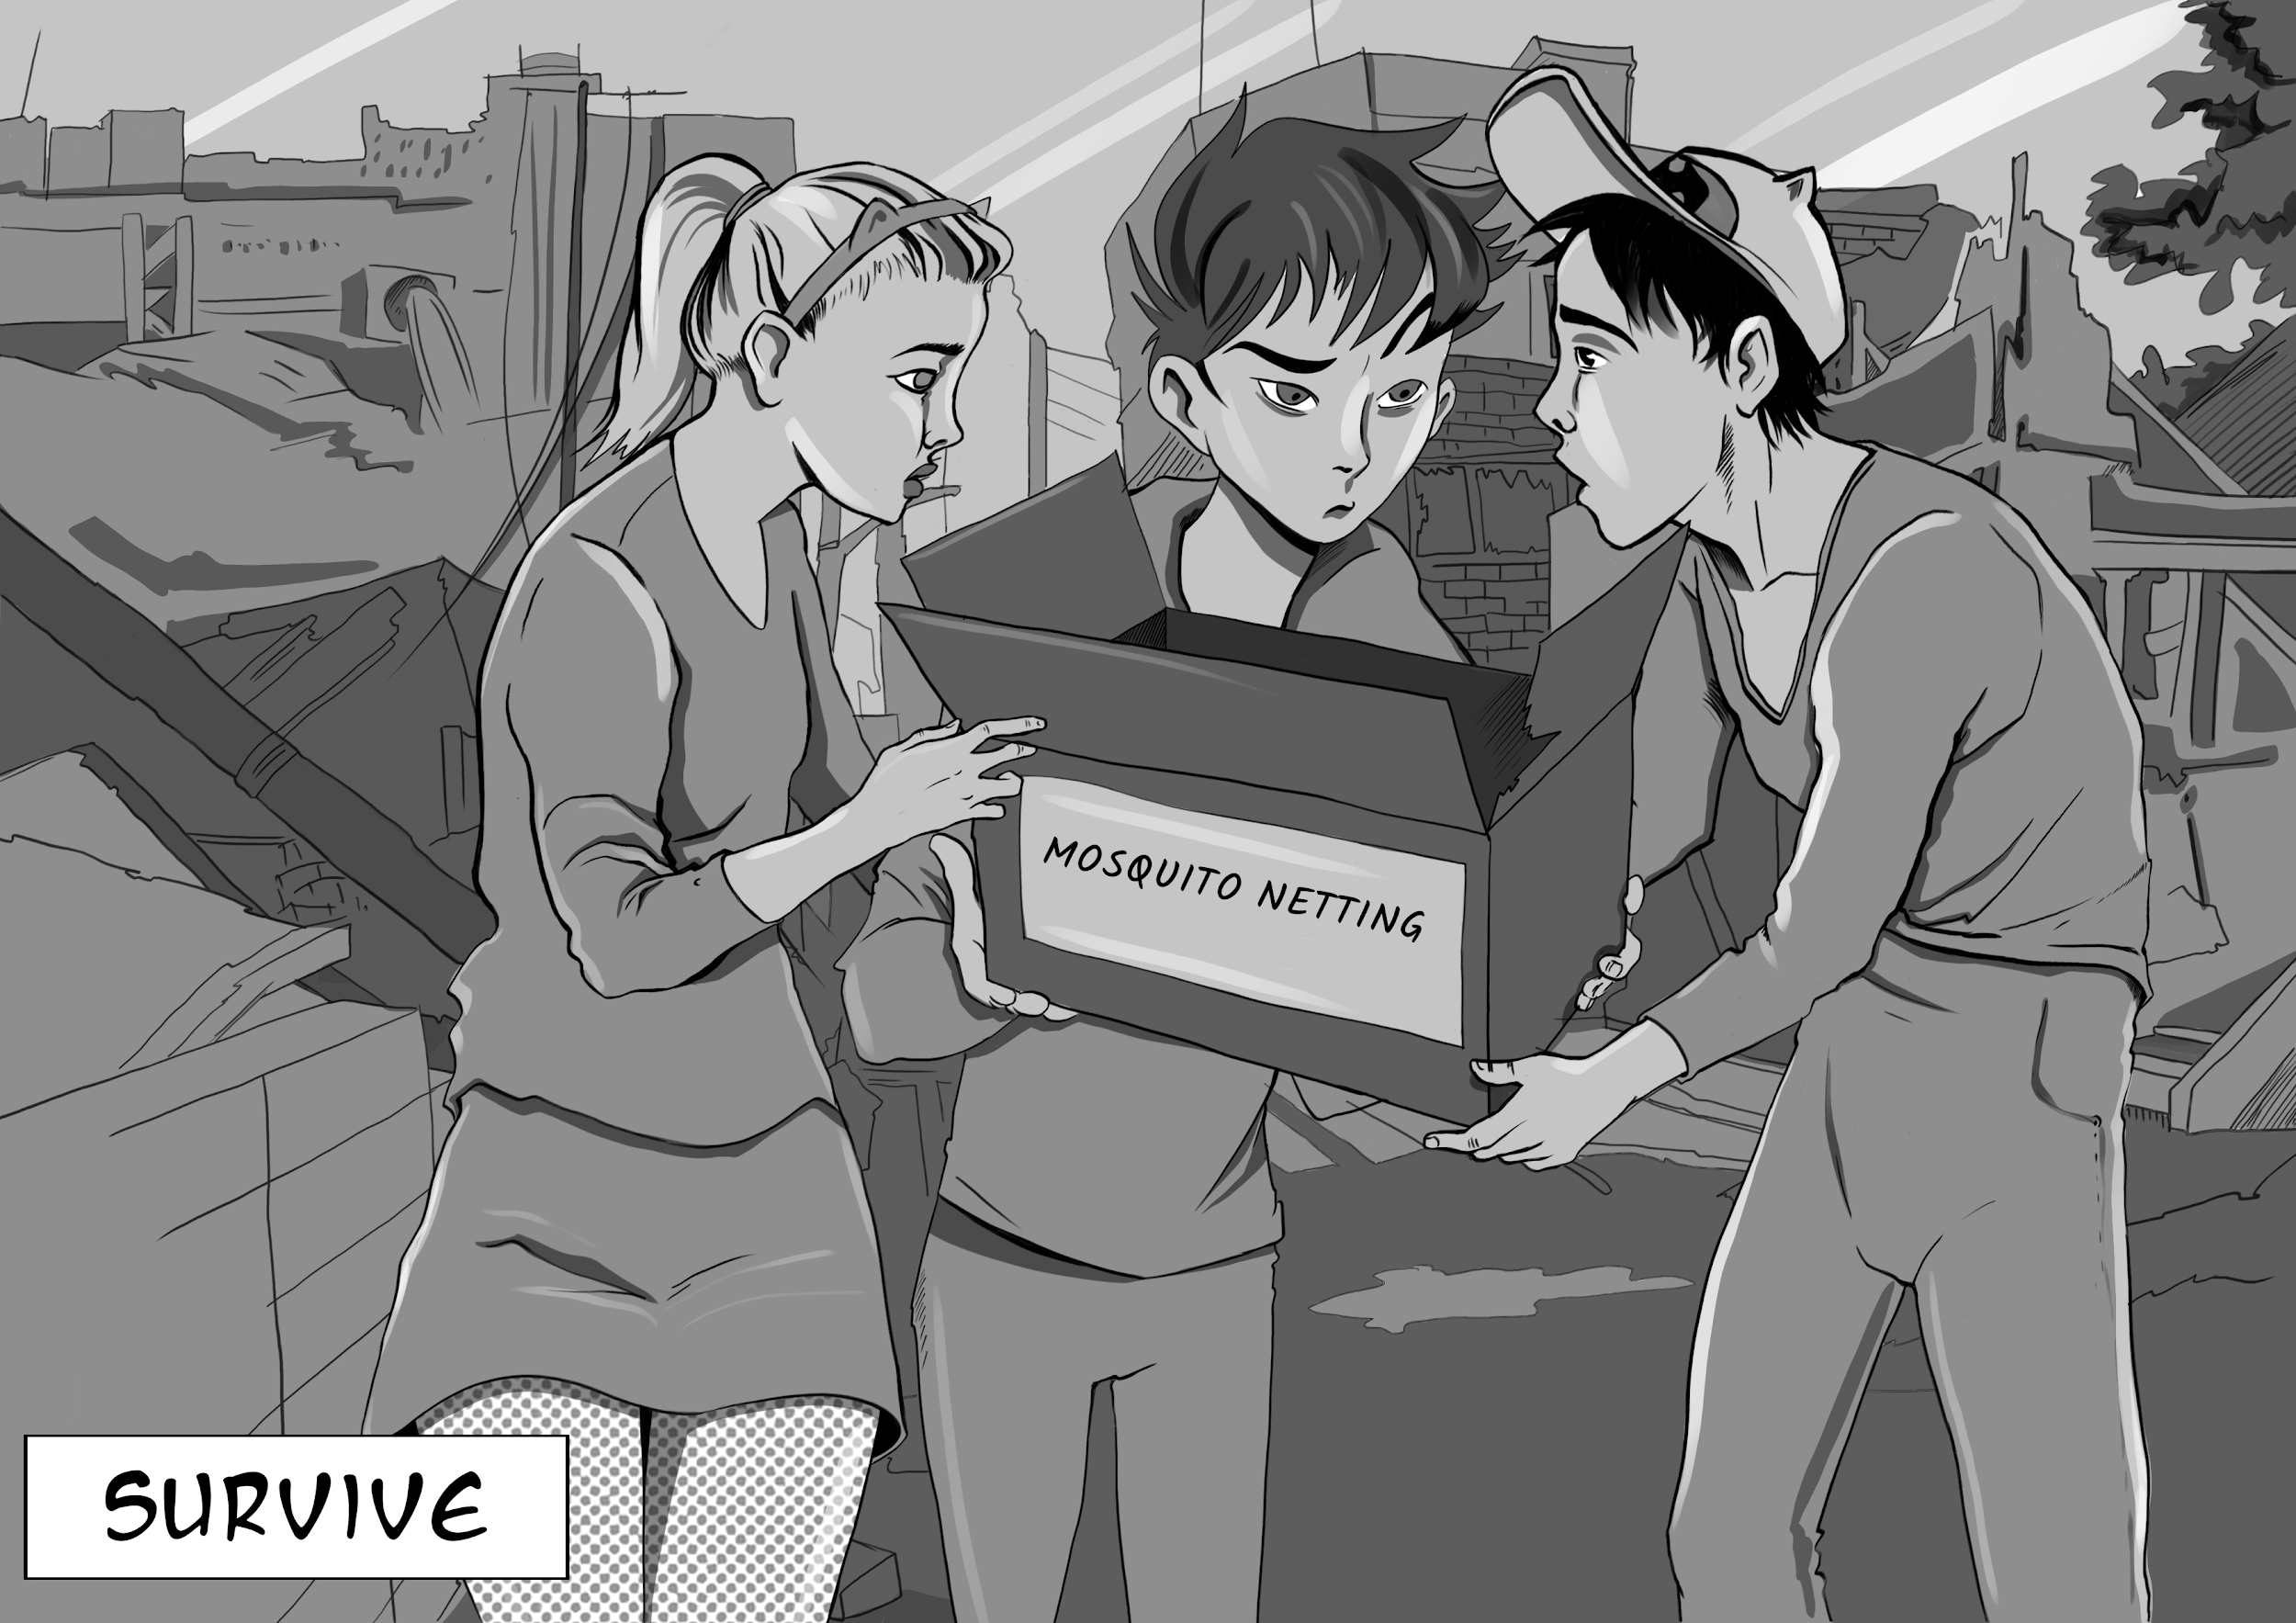
Survivor’s Path - Survive
Essential Question: How can I prepare for any disaster or disruption of normal societal systems?
Are you prepared for a zombie apocalypse? Have you ever once asked a parent or teacher “when am I going to need this?” Well…
The need to go out and get help, get needed medicine, obtain food and water, and/or satisfy other needs might be dangerous or impossible in situations such as natural disasters or national emergencies. The CDC wants people to pay attention to this problem so they chose zombies for their theme. Can you answer the question?
Vocabulary:
Activity: CDC Preparedness

Slide 13
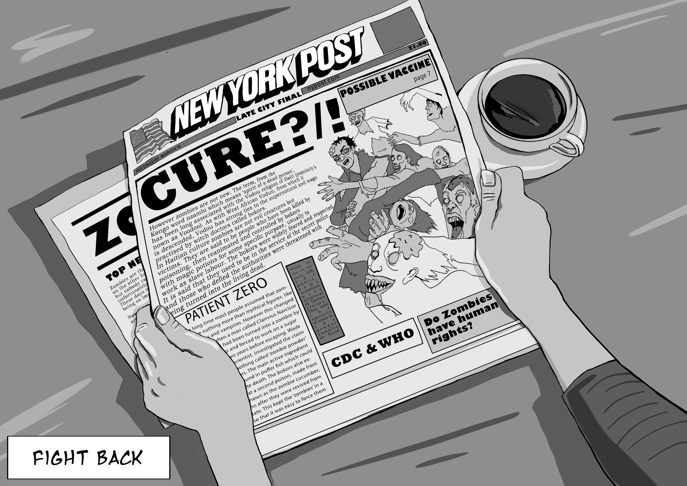
Survivor’s Path - Fight Back
Essential Question: Why should you not take antibiotics to treat a viral zombie apocalypse?
During any disease outbreak, medical systems are put under great pressure. First responders can also be the first infected in a spreading disease. This is one of the reasons that first responders are often the first vaccinated. The science of vaccinations is known as immunology. In a few countries, individual desires not to vaccinate are being weighed against the societal benefits of herd immunity. Identifying trusted sources of peer reviewed data leads to better and more informed choices.
Vocabulary:
Activity:

Slide 14
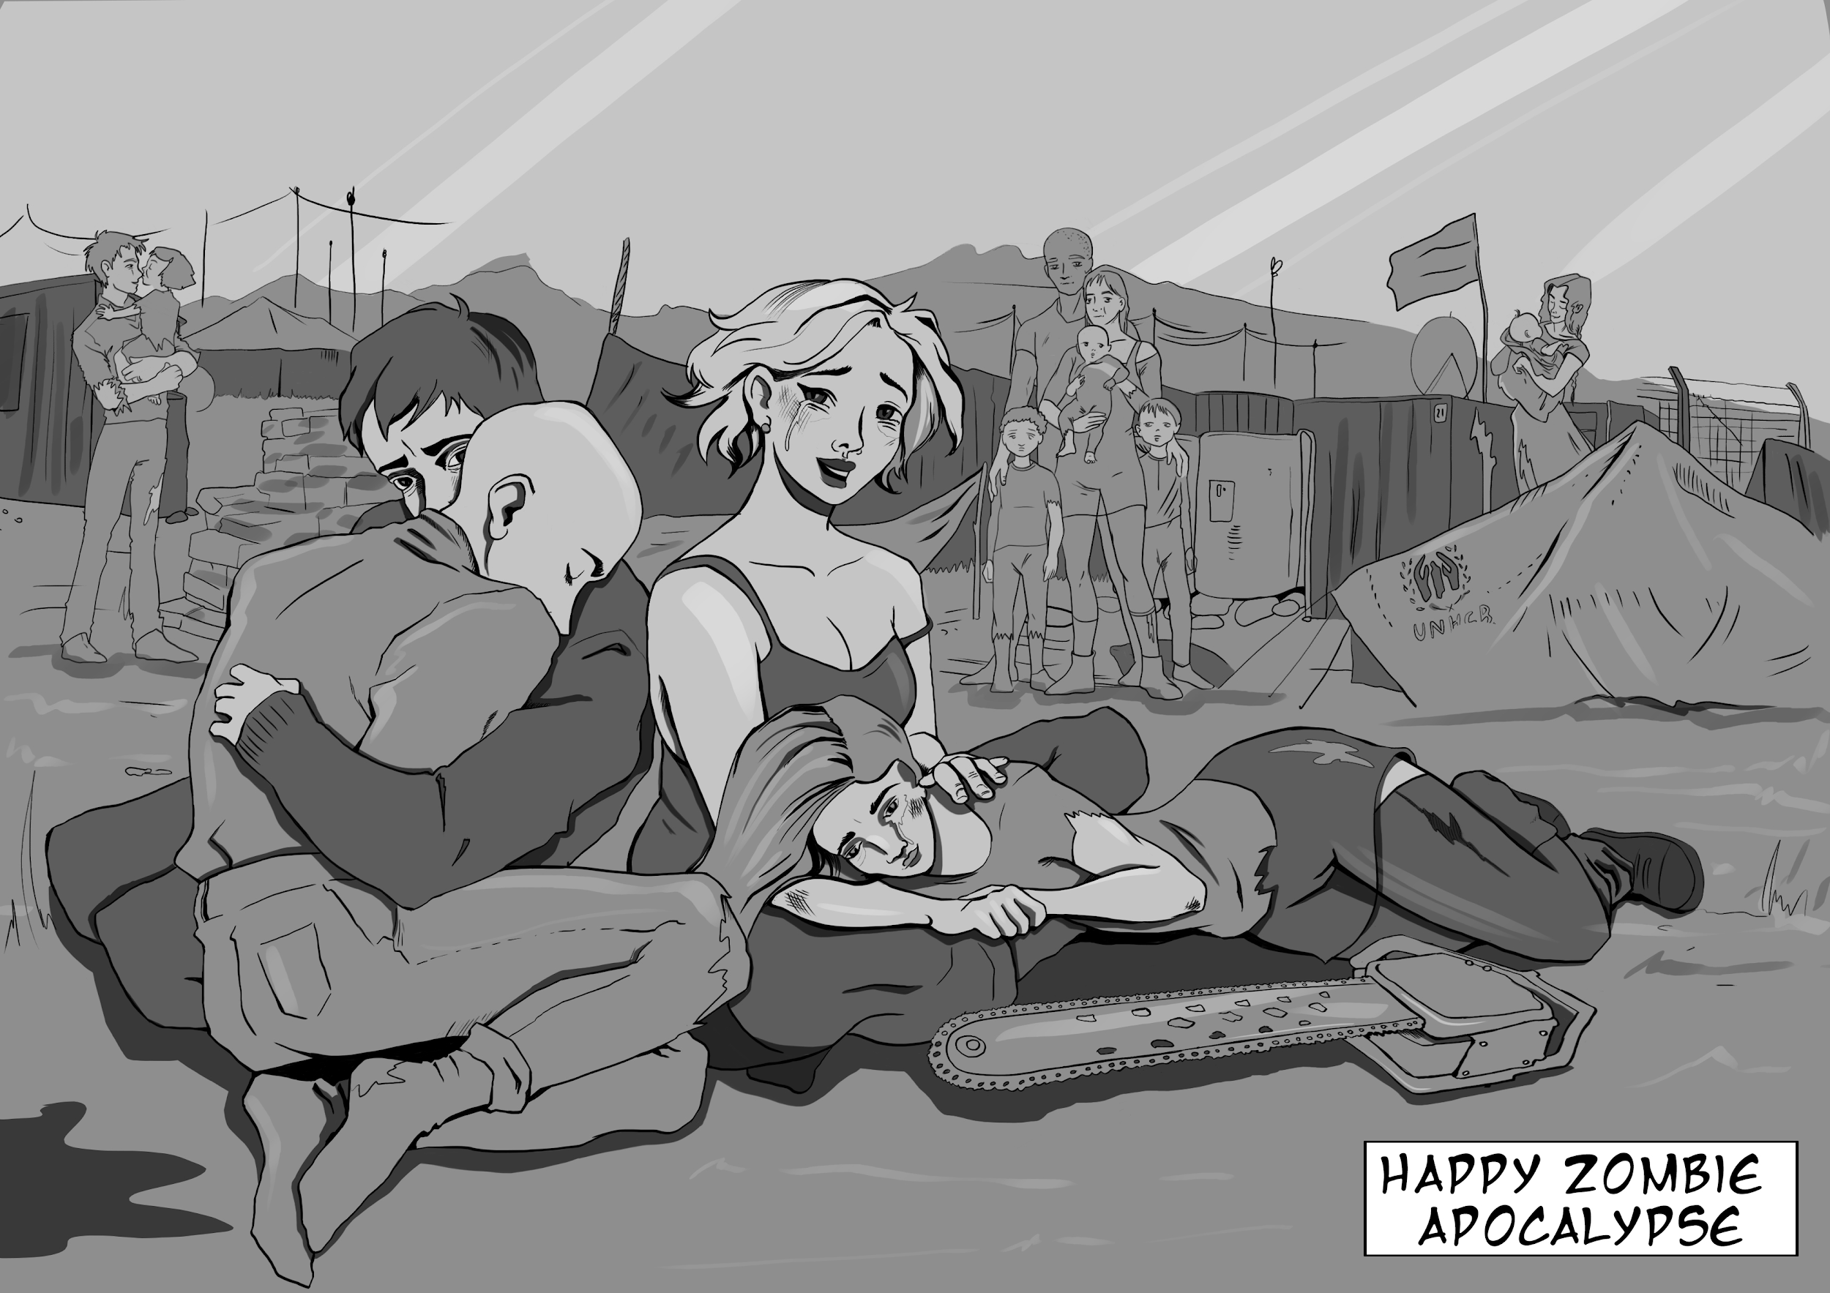
Survivor’s Path- Happy Zombie Apocalypse Day
Essential Question: Are you better prepared for a zombie apocalypse?
You should now know many of the things you can do to protect yourself and your family during a disease outbreak. You should better see how fear results from a lack of knowledge. Understanding the disease triangle allows you to make informed decisions. Occurrences such as a severe disease outbreak, natural disaster, or any other sustained disruption of day to day life have the ability to interrupt necessities such as food, water, medecine, and utilities. If you prepare yourself for a zombie apocalypse then you will be better prepared for any disaster.
Andy and Nikki made it back to their family. So will you!
Vocabulary:
Activity:

Slide 15
Then the Game - Happy Zombie Apocalypse Day!
During your academic journey through the survivor’s path, your teacher will be looking for heroic acts of thought and deeds.
For acts of academic success, you will be given water tokens.
For specified good deeds, you will be given food tokens.
These are your preparations for the zombie apocalypse. Do your best. If you are keeping a Survivor’s Journal, keep a record of your earned tokens. You may even want to say how you found that water and food in a world rushing towards the zombie apocalypse.
Happy Zombie Apocalypse Day awaits you at the end of the Survivor’s Path.

Slide 16
Teacher Suggestion- Formative Assessment & the RAC
The information on the next slide is an example of how I used gamification to solve a growing problem with Formative Assessment.
In a traditionally graded classroom I faced the problem with the students who would not study for the quizzes, and put all of their efforts into the final summative test.
In a standards based classroom some educators feel that ungraded formative assessments lack an incentive for the student to do their best.
A game mechanic that I use for many of my classroom games is the Random Answer Card or RAC. I provide a brief description for your student/players on the following yellow slide. Keep it or delete it as suits your needs.
Gamification Schoolhouse has other products using this mechanic, support videos for this and other products, and even training on gamification at www.gamificationschoolhouse.com.

Slide 17
Fast assessment in the Apocalypse. The RAC
Zombies and quizzes can really ruin your day. Because this is just a game, it’s not about having to win, it’s about how you play the game. Quizzes as you knew them are now dead, they have become the Random Answer Card. That’s right, expect a swarm of RAC’s during this apocalypse!
Here is how it will work: Your teacher will pass out an index card to each student. Always place your Name on the card. In the game, even if you get the answer wrong, you can still win points.
Usually you will have just 60 seconds to write down the information requested for that RAC. You have to think fast in a Zombie Apocalypse! Your teacher will then collect all of the cards and shuffle them. After rolling a 3 sided dice your teacher will read aloud one (on a roll of 1,2), two (on a roll of 3,4), or three cards before they read the RAC.
If the card selected has the correct answer, then 3 Water Tokens (minimum) will be given to the class to spend on HZAD supplies. The first Water goes to the student/player who correctly answered the RAC. The next two coins will be given at random to students/players from the stack of RAC cards. Previously pulled cards should be shuffled in.

Slide 18
The Game, H.Z.A.D., and the final roll
Surviving (or not) a zombie apocalypse involves a bit of luck. On the final day, you will celebrate Happy Zombie Apocalypse Day. You will roll 5 dice. Your fate will be determined by the combined score.
Roll Fate
28-30 Zombie Hero!
Your picture on the final class poster. Want a chainsaw in your hands? Earn it!
14-27 Zombie Survivor
Your name is placed under “Also Starring” section of the class poster.
5-13 Messy Death
Nothing. You died. An “extra” for H.Z.A.D.. Your teacher may include zombie you in the final poster in some other way.

Slide 19
H.Z.A.D. and the Epic Win!
Do you want to be a zombie hero?
OR
Will you become a member of the mindless zombie horde?
“Fortune favors the prepared mind.”
This could be you!
Want a chainsaw to be in your hands? Ask your teacher what you can do to prove yourself worthy of this elite winnable game item!
Nikki, Andy
You?
Your surviving friends who are not as cool as you, or zombies.

Slide 20
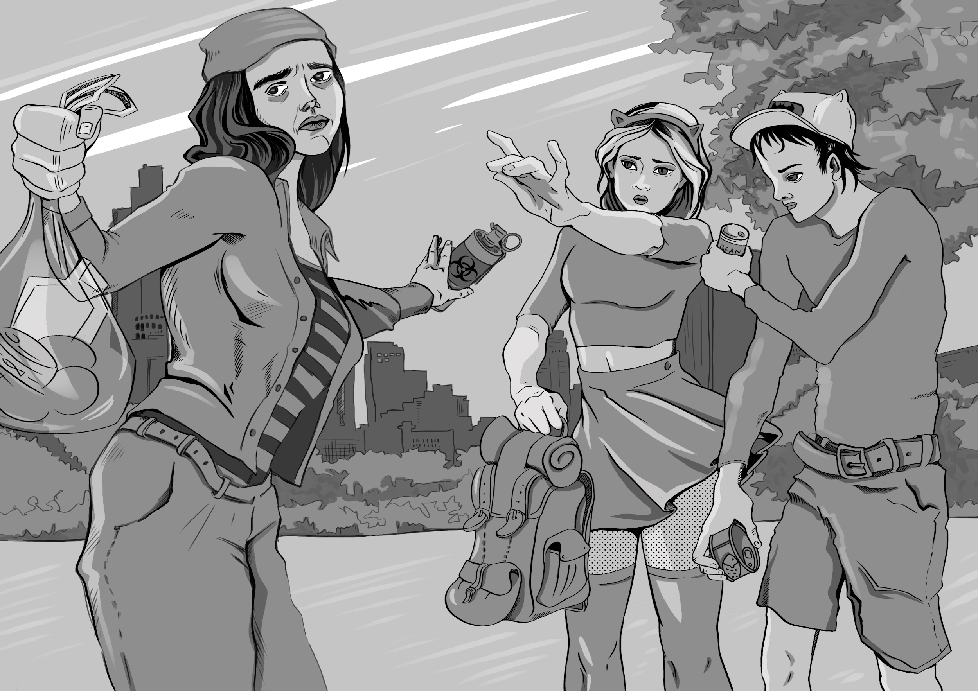
H.Z.A.D.
Trading in Food & Water
On Happy Zombie Apocalypse Day, your preparations will pay off. Before the rolling of any dice, you will be given a chance to trade in any of the food and water tokens you have managed to collect in you preparations. Your teacher will provide you with a price list for the cost of various items local starving survivors are willing to trade for your food and/or water. You are about to make your final dash to rescue. Take a final sip of water, and trade it all to improve your chances in your final dash to safety. The prices, once set, are not negotiable.

Slide 21
The H.Z.A.D. store. All sales are… final.
First Aid- 1 food/water
Adv. First Aid- 3 food/water
Z.A.P.- 2 food/water
Bieber Bomb- 4 food/water
Elite Items Open for trade, not sale
Chainsaw- Teacher created win condition
Backpack- Teacher created win condition
Prices subject to change. It’s the Apocalypse, you expect consistency?

Slide 22
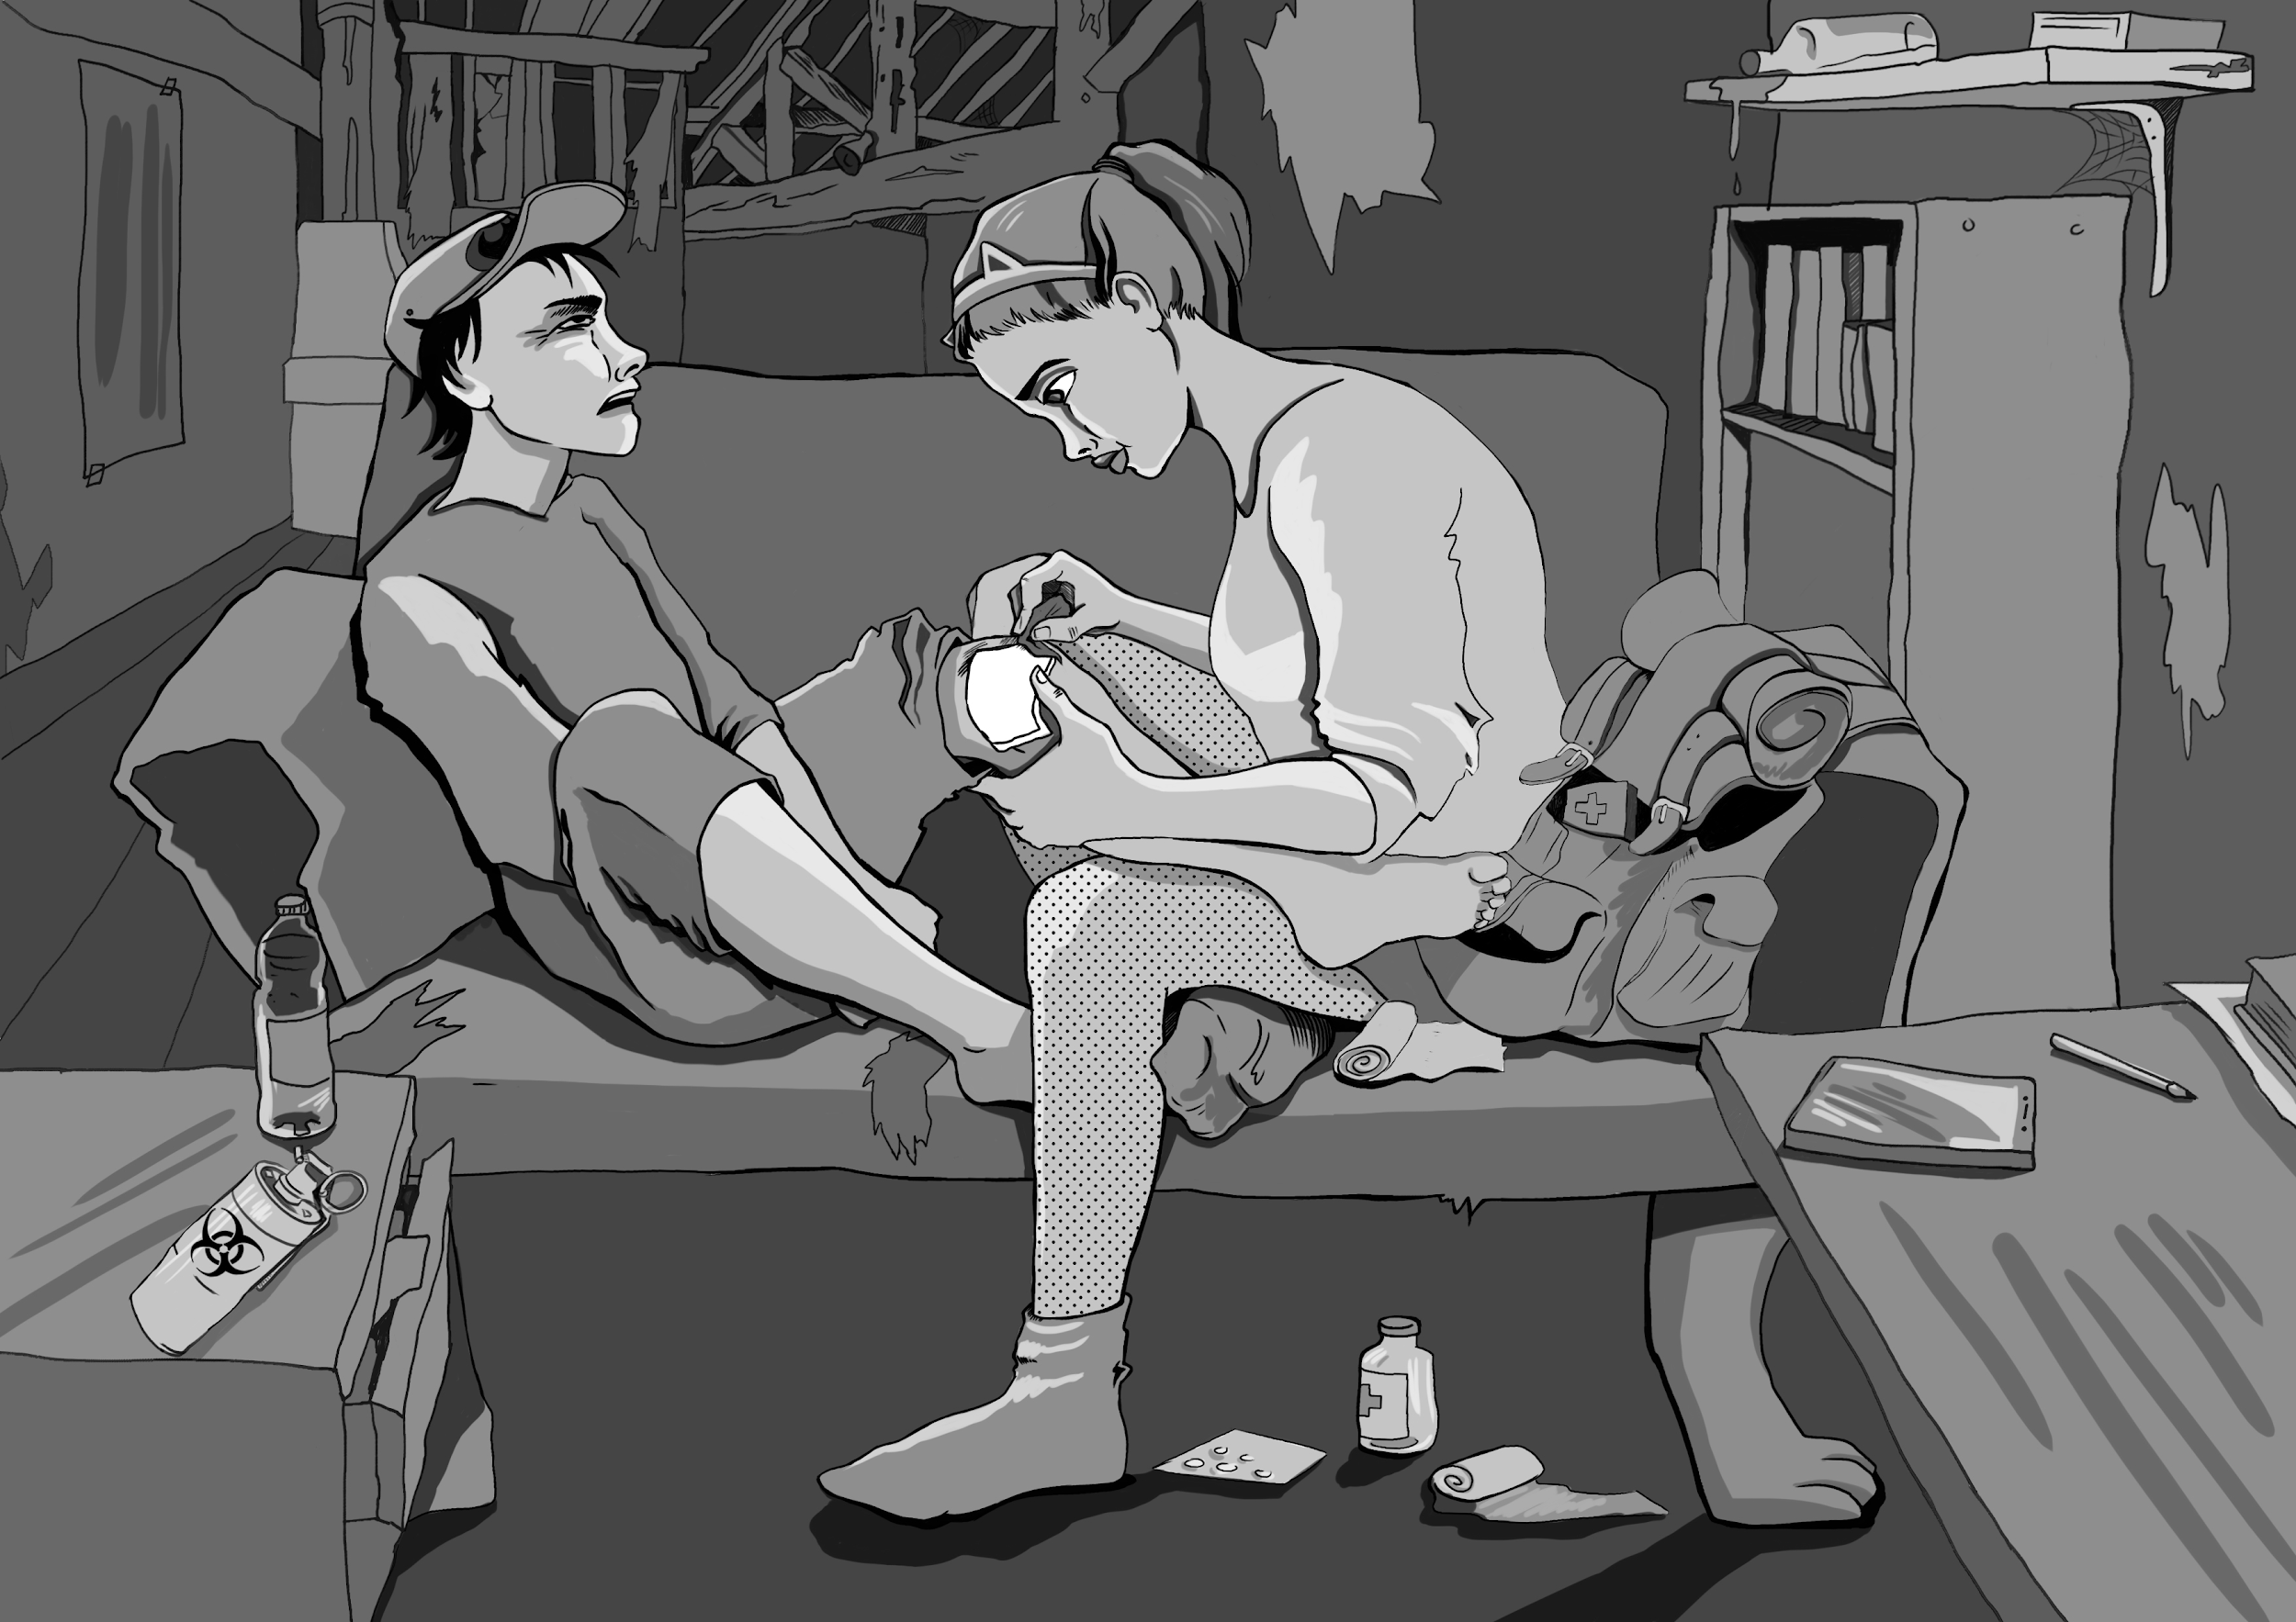
Game Items - First Aid and Advanced First Aid
First Aid: Not just band aids. A good basic kit has bandages, pads, antiseptic, scissors, tape, and other supplies needed to treat small cuts, dress small wounds, and prevent infection.
Advanced First Aid: A field medic in a bag. Ideally used by someone with training, this kit has additional supplies and tools that would allow a user to stitch and treat wounds, provide pain relief, and perhaps even a charged AED!
If any family member has a prescription drug need a 1 month supply of that drug should alway be kept in your 1st aid kit.
Game Effects
1st Aid: +1 to any rolled dice (1 per dice)
Advanced 1st Aid: Like 1st Aid but +2

Slide 23
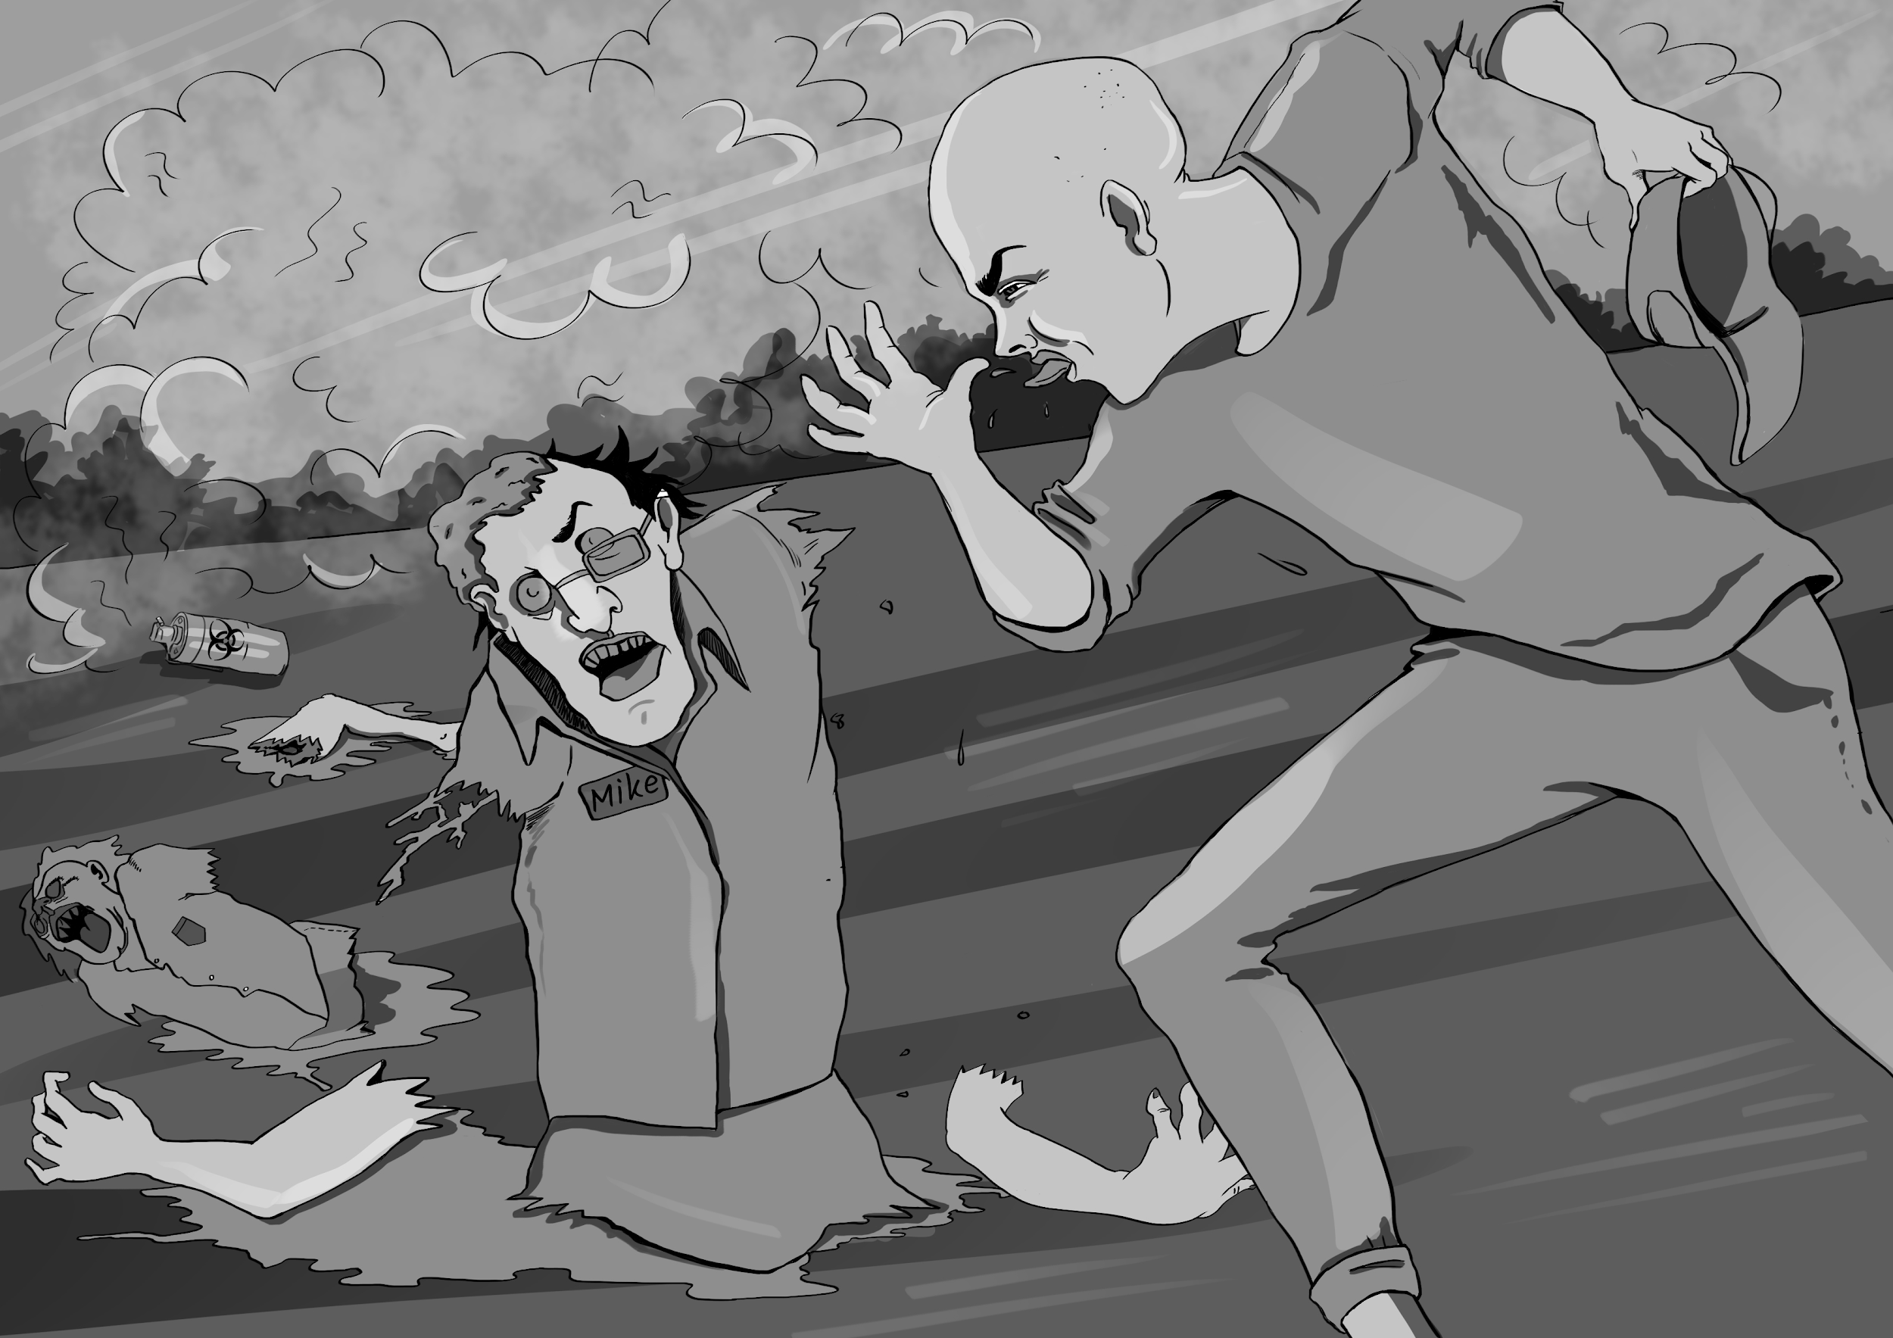
Game Items - Z.A.P.
Zombie Affecting Pathogen: Some discoveries come almost too late to make a difference. Soon after the plague began rumors talked about attempts to engineer a pathogen that would affect zombies but not harm humans. Using a highly modified version of a Necrotizing fasciitis (flesh eating) pathogen, scientists succeeded, but is it too late? This version of the bacteria causes the arms and legs of a zombie to become useless, and soon after, fall off. The pathogen is released as an aerosol. Humans who breath enough of this aerosol will only experience the loss of all hair. No one yet knows if it will regrow.
Game Effect
During the final rolls, you may pick up and reroll 1 die

Slide 24
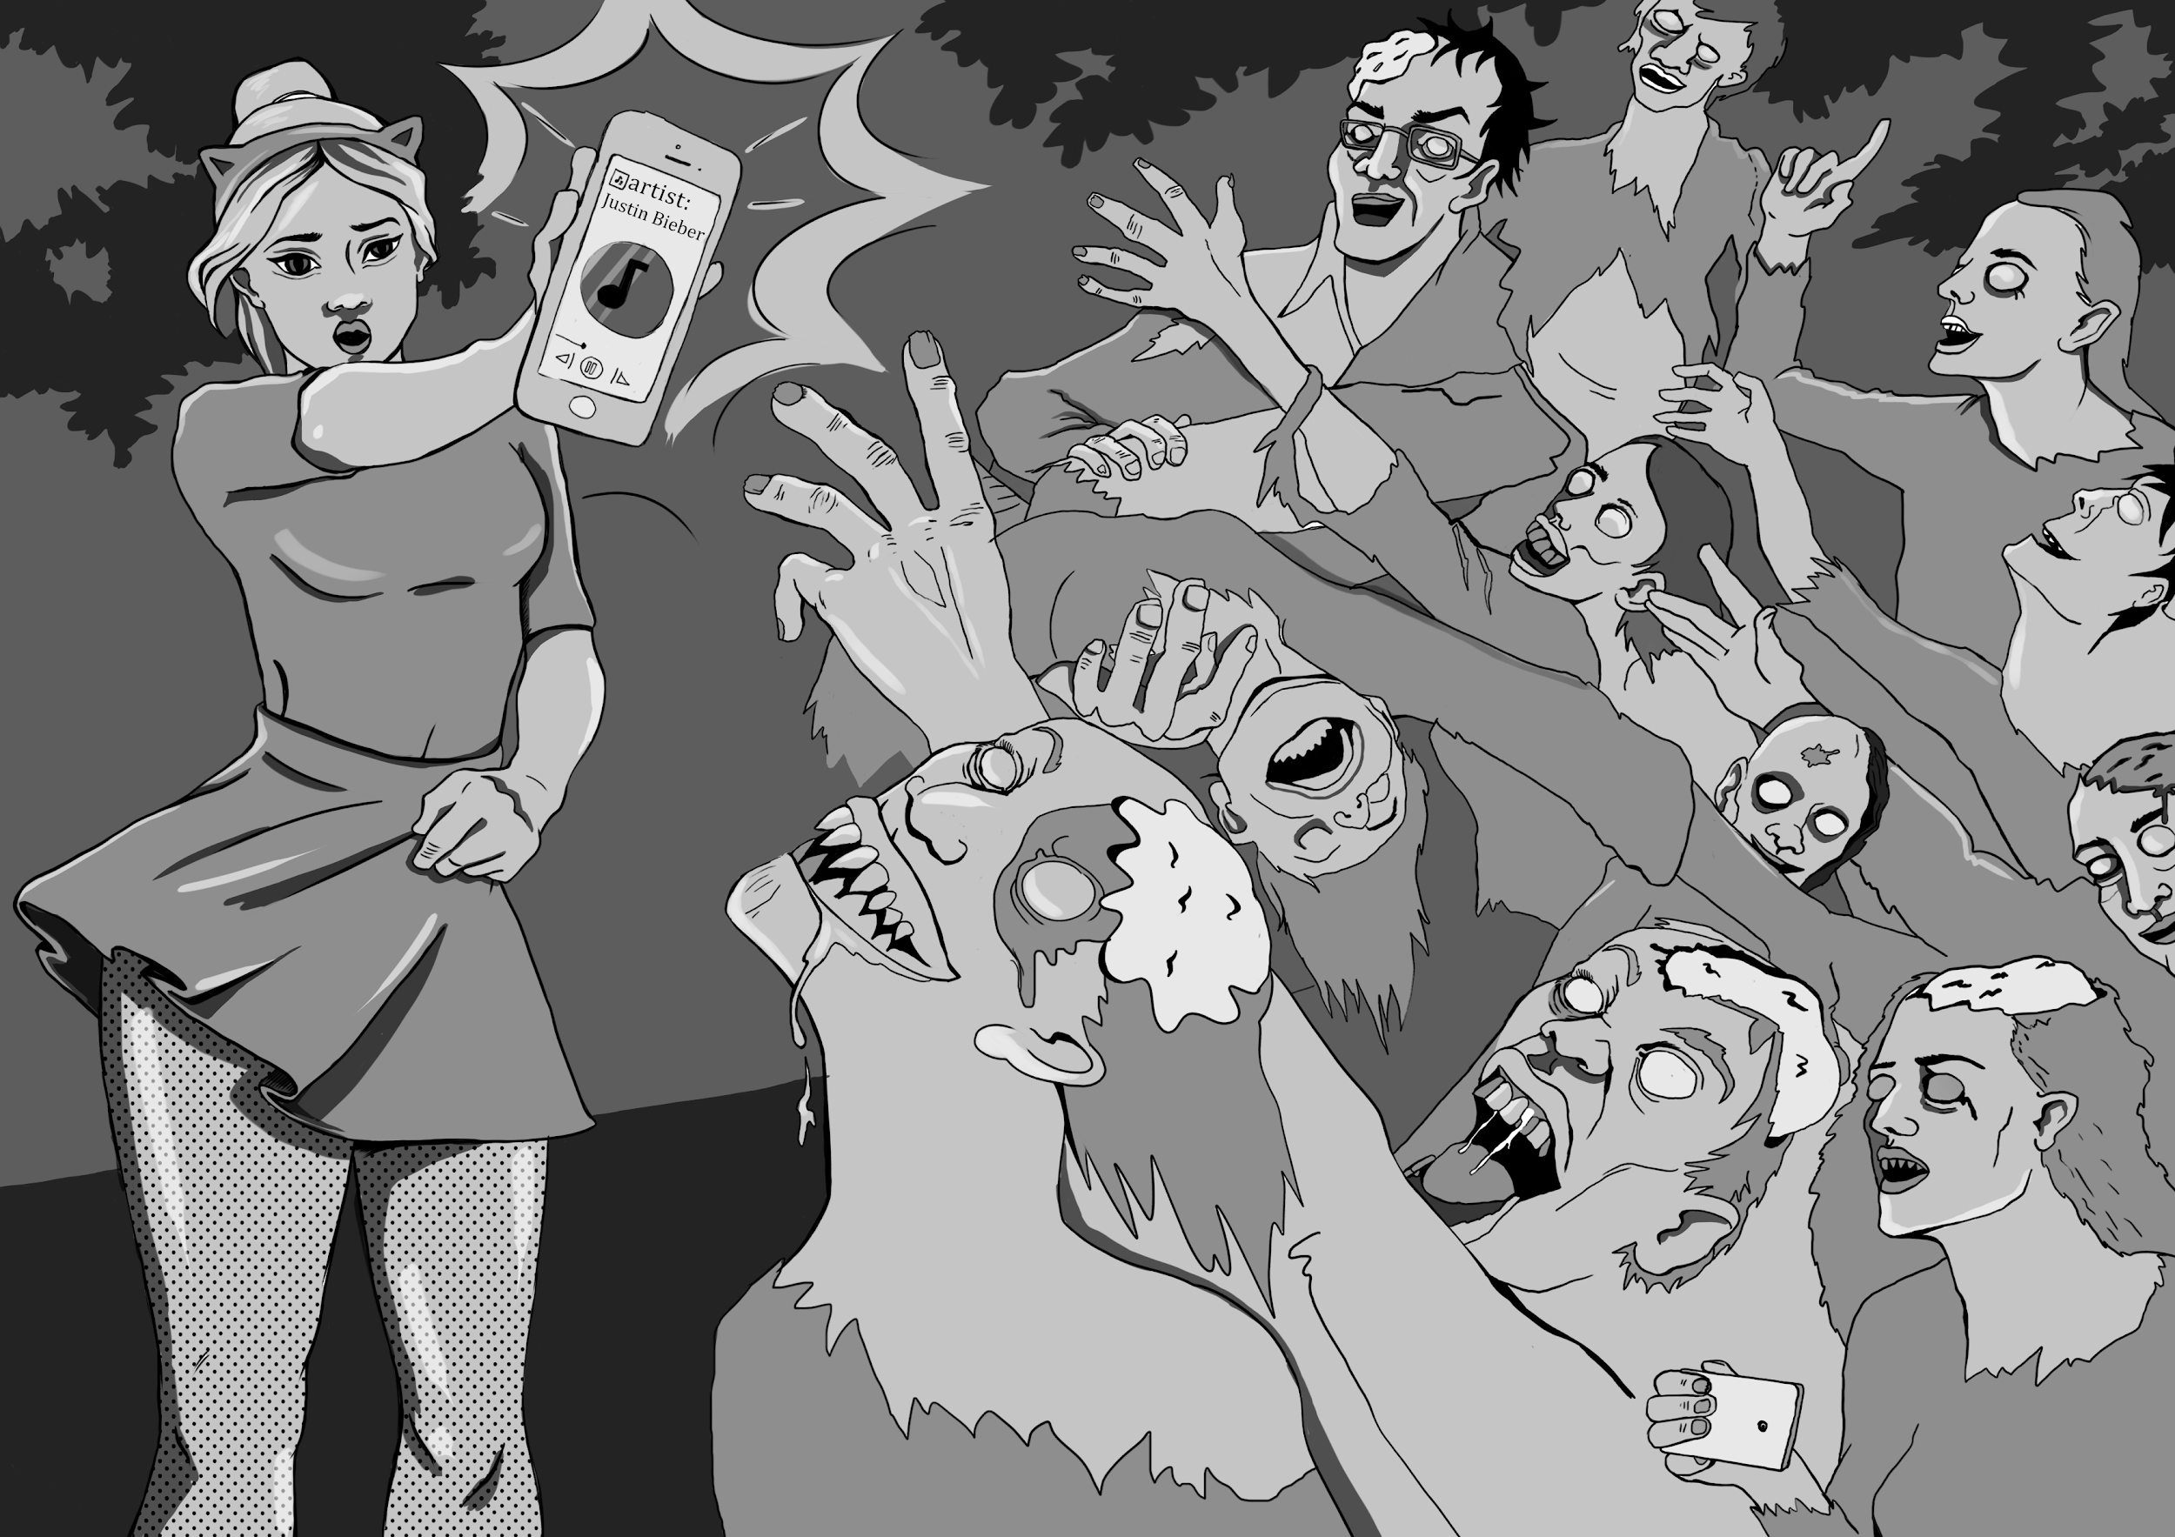
Game Items - The Bieber Bomb
Some discoveries are intentional; others are found by accident. During the zombie apocalypse, it was found quite accidentally that the melodies of one Justin Bieber had a unique effect on zombies. Upon hearing the voice of Justin Bieber, zombies will stop and sway to the music.
Almost instantaneously a number of teen fans of Justin Bieber became very smug as new friends huddled around their device. But beware! Do not let yourself get surrounded. If the music stop, so do you! Best to drop the device and run away.
Game Effect
During the final rolls, you may pick up and reroll 2 dice at the same time

Slide 25
Game Items [Elite] - Chainsaw
Big, heavy, hard to operate well, requires fuel, is LOUD, and if used against the pathogen ridden “undead” would certainly throw out a dangerous cloud of potentially infectious material. It’s enough to make one believe that Hollywood has not really thought this through. However, this legendary icon of the zombie apocalypse has a role in Happy Zombie Apocalypse Day. Zombies are slow. The problem is usually not speed, but rather finding an escape route or building a sturdy barrier.
This object can only be won, not purchased.
Game Effect
During the final rolls, you may pick up and reroll 3 dice at in any order!

Slide 26
Game Items [Elite] - Backpack
As our heroes Nikki and Andy find out, when things go bad, you can only carry so much in your hands, especially if they are full wielding a chainsaw! In the event of an emergency, it is always better to have an emergency pack ready made, as suggested by the CDC. Nikki and Andy get very lucky in that they find a backpack early on and fill it with things they either found or traded precious food and water for.
This object can only be won.
Game Effect
+ 8 items brought into the final round for a total of 10!

Slide 27
Baby,baby.…ooooo.
User Agreement/Copyright
Happy Zombie Apocalypse Day and the art within, is copyrighted. More importantly, it is a work created by teachers for teachers. Feel free to pass this product on, so long as Gamification Schoolhouse is credited.
If you want ideas on how you might adapt this product, or gamification in general, to your individual classroom needs visit us on the web at www.gamificationschoolhouse.com

Slide 28
Connect with
Gamification Schoolhouse to explore educational gamification
Feedback welcome!
Also, if you would like help in creating a schoolwide integrated unit on this topic, we have done it before. Contact us for details.

